Slide 1
Storing numbers
Shiva K

Slide 2
Many problems we have to solve involve maths.
How much will I pay monthly on mortgage?
How much will cost when I add taxes ?
How much milk do I need to add in this recipe in order to make this double?

Slide 3
So, it is important to be able to store and manipulate numbers
age = 32
print(age)

Slide 4
You can perform math operations on numeric values or on variables contain numeric values
width = 20
height = 5
area = width * height
Perimeter = 2 * ( width + height )

Slide 5
These are the most common math(Arithmetic) operations
Symbol | Operation | Example
+ | Addition | 5 +3 = 8
- | Subtraction | 6-2 = 4
** | Exponent | 5 ** 3 = 125
* | Multiplication | 6 * 2 = 12
/ | Division | 33 / 3 = 11
% | Modulo | 5 % 3 = 2

Slide 6
Math rules have not changed since school(BODMAS).
Order of operations:
( ) Parentheses
** exponent ( 2 ** 2 = 4 or 2 ** 3 = 8 )
* , / Multiplication or division
+ , - Addition and Subtraction

Slide 7
Getting a computer to do your math work
Formatting numbers

Slide 8
Sometimes you need to format your numbers before you display them to users.
Syntax | Output
print(‘I have %d cats’ % 6) | I have 6 cats
print(‘I have %3d cats’ %6) | I have 6 cats
print(‘I have %03d cats’ %6) | I have 006 cats
print(‘I have %f cats’ %6) | I have 6.000000 cats
print(‘I have %.2f cats’ %6) | I have 6.00 cats

Slide 9
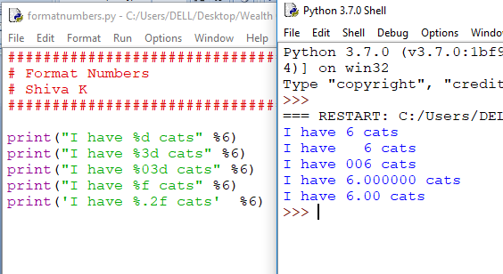

Slide 10
You can also use format method to format numeric values
Syntax | Output
print(‘I have {0:d } cats’ .format( 6)) | I have 6 cats
print(‘I have {0:3d } cats’ .format( 6)) | I have 6 cats
print(‘I have {0:03d } cats’ .format( 6)) | I have 006 cats
print(‘I have {0:f } cats’ .format( 6)) | I have 6.000000 cats
print(‘I have {0:.2f } cats’ .format( 6)) | I have 6.00 cats

Slide 11
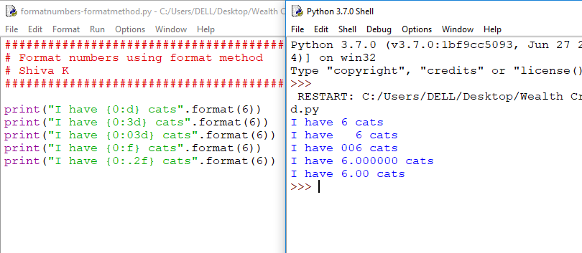

Slide 12
Geek tip!
Sometimes commands are too long to fit on single line.
You can use “\” to indicate command continues on the next line.
total = 5 + 6 + 8 \
9 + 10

Slide 13
Inputting numbers
Asking user to enter the numbers.

Slide 14
Why did we get the wrong answer we ask the user to enter the values??
Salary = input(“What is your salary? ”)
Bonus = input(“What is you bonus? ”)
payCheck = Salary + Bonus
print(payCheck)

Slide 15
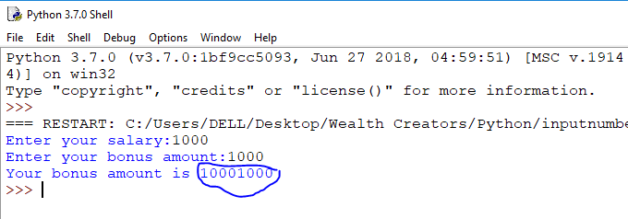
Why did we get the wrong answer we ask the user to enter the values??

Slide 16
Hint:
Input function returns string

Slide 17
Interpreter thought salary and bonus were string variables,so it concatenated both the strings
So, there is a need to tell the program that we want the input to be taken as a number.

Slide 18
There are functions to convert from one datatype to another
int(value) : Converts value to an integer
long(value) : Converts value to a long integer
float(value) : Converts value to floating variable which can hold decimal values also
str(value) : Converts value to string

Slide 19
Which function should we use to fix our code??
salary = input(“Enter your salary:”)
bonus = input(“Enter your bonus:”)
payCheck = float(salary) + float(bonus)

Slide 20
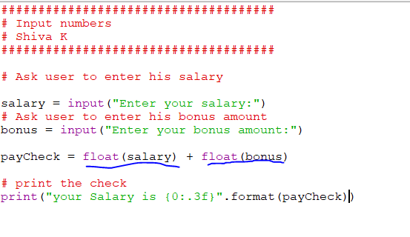

Slide 21
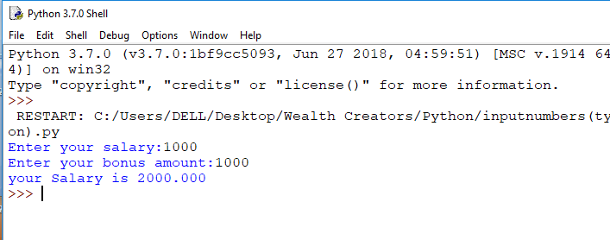

Slide 22
What will happen if someone gives BoB as their salary?
The code crashes because we can not convert the string value to float or integer value. We will error handling later.

Slide 23
Your Challenge – create a loan calculator
Have the user enter the cost of the loan, the interest rate, and the number of years for the loan
Calculate monthly payments with the following formula
M = L[i(1+i)n] / [(1+i)n-1]
M = monthly payment
L = Loan amount
i = interest rate (for an interest rate of 5%, i = 0.05)
n = number of payments

Slide 24
Congratulations!
You can now solve mathematical problems using code!

